Slide 1

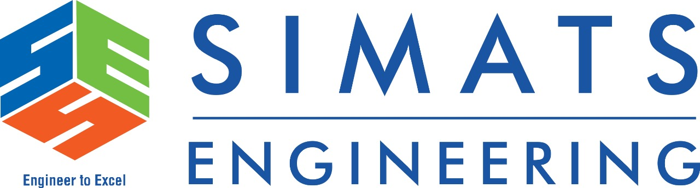
OPERATING SYSTEM
Virtual Memory Concepts, Techniques ,And Applications
B.GANESH(192225079)
S.UDAY KUMAR(192225101)
BY
DR.G.MARY VALANTINA
SIMATS ENGINEERING

Slide 2

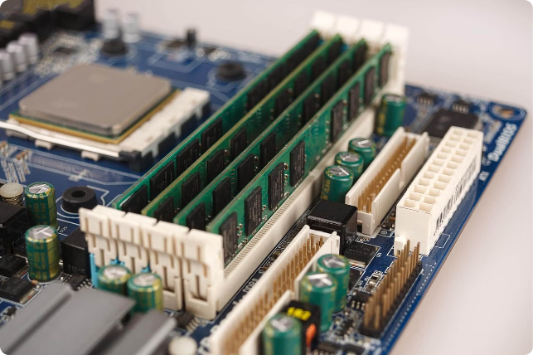
Virtual Memory: Concepts, Techniques, and Applications
Virtual memory is a memory management technique that allows a computer to run programs larger than the physical memory available. This is achieved by using a combination of physical memory and secondary storage, such as a hard disk, to create the illusion of a larger address space.

Slide 3

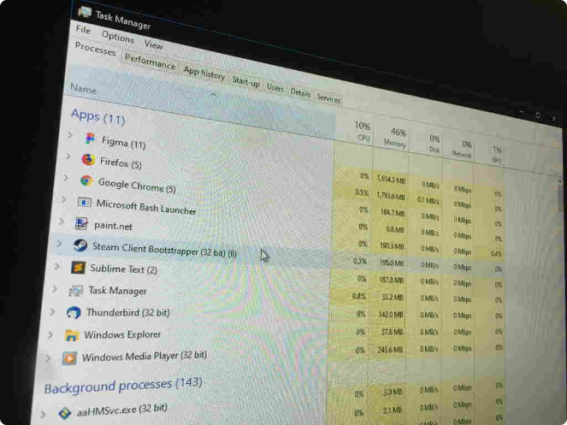
Abstraction and Introduction to Virtual Memory
Virtual memory is a concept that hides the complexities of physical memory management from the user and applications. It allows programs to access more memory than physically available by using secondary storage to store inactive portions of the program. This enables more programs to run simultaneously and reduces fragmentation.
Virtual Address Space
Programs operate within a virtual address space, which is a logical view of memory. This virtual space can be much larger than the physical memory space.
Physical Memory
Physical memory is the actual RAM installed in the computer. It is a limited resource, and virtual memory is used to extend its capacity.
Secondary Storage
Secondary storage, such as a hard disk, serves as an extension to physical memory. It stores inactive portions of programs and data that are not immediately needed.

Slide 4

Fundamental Concepts of Virtual Memory
Virtual memory relies on several key concepts to manage the flow of data between physical memory and secondary storage. These concepts ensure efficient and effective use of available resources.
1
Address Translation
2
Page Faults
The process of converting virtual addresses used by programs to physical addresses in RAM.
When a program tries to access data that is not present in physical memory, a page fault occurs, triggering the retrieval of the necessary data from secondary storage.
3
Page Table
4
Memory Management Unit (MMU)
A data structure that maps virtual addresses to physical addresses, used by the operating system to manage memory access.
A hardware component that performs address translation and manages page faults.

Slide 5
Paging and Segmentation Techniques
Paging and segmentation are two primary techniques used in virtual memory management. These methods allow for efficient allocation and management of memory resources.
Paging
Segmentation
Divides the virtual address space into fixed-size units called pages. Each page is mapped to a physical frame in RAM.
Divides the virtual address space into logical units called segments, each representing a specific program or data structure.
Simplified memory management
Provides logical organization of memory
Efficient use of physical memory
Supports sharing of memory segments between programs
Allows for flexible allocation of memory to programs
Protects data and code from unauthorized access

Slide 6
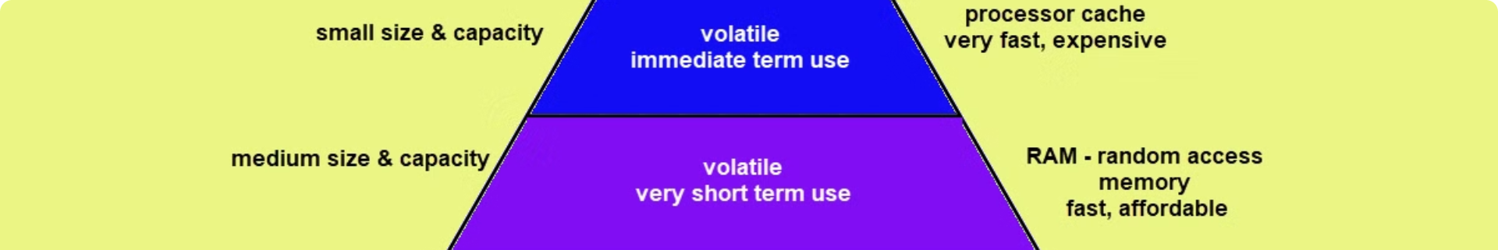



Page Replacement Algorithms
When physical memory is full, the operating system must decide which page to evict to make space for a new page. Page replacement algorithms help make these decisions efficiently.
FIFO (First-In, First-Out)
LRU (Least Recently Used)
Optimal Algorithm
Evicts the oldest page in memory, regardless of its usage.
Evicts the page that has not been accessed for the longest time.
Evicts the page that will not be used for the longest time in the future. It is a theoretical algorithm used as a benchmark.

Slide 7

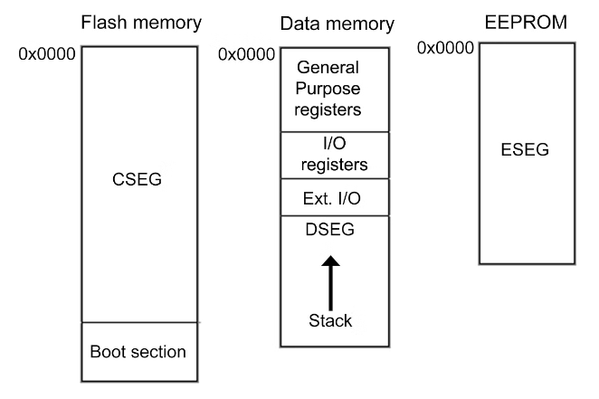
Output:
+-----------------------------------------------+
| Virtual Memory |
+-----------------------------------------------+
| Process |
| +-----------------------------------------+ |
| | Virtual Address Space | |
| +-----------------------------------------+ |
| |
| +-----------------------------------------+ |
| | Page Table | |
| | +-----------+ +-----------+ | |
| | | Page 1 | --> | Frame 5 | | |
| | | Page 2 | --> | Frame 2 | | |
| | | ... | | ... | | |
| | +-----------+ +-----------+ | |
| +-----------------------------------------+ |
| |
| +-----------------------------------------+ |
| | Paging Mechanism | |
| | +-----------+ +-----------+ | |
| | | Page 1 | | Frame 5 | | |
| | | Page 2 | | Frame 2 | | |
| | | ... | | ... | | |
| | +-----------+ +-----------+ | |
| +-----------------------------------------+ |
| |
| +-----------------------------------------+ |
| | Page Replacement | |
| | +-----------+ +-----------+ | |
| | | Page 1 | | Frame 5 | | |
| | | Page 2 | | Frame 2 | | |
| | | ... | | ... | | |
| | +-----------+ +-----------+ | |
| +-----------------------------------------+ |
| |
| +--------------------------------------------+|
.

Slide 8

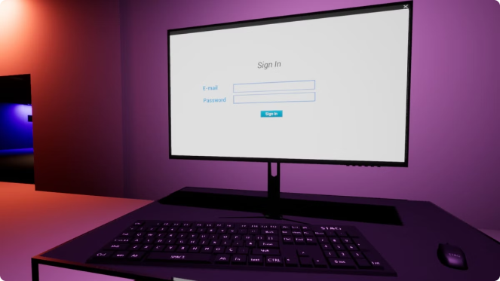



Virtual Memory and Operating Systems
Virtual memory is an essential component of modern operating systems. It provides a foundation for managing memory resources efficiently, enabling multitasking and improved system performance.
Multitasking
Virtual memory allows multiple programs to run concurrently, sharing memory resources effectively.
Memory Protection
Virtual memory mechanisms isolate programs from each other, protecting their data and code from unauthorized access.
Security
Virtual memory contributes to system security by controlling memory access and preventing malicious programs from accessing sensitive information.

Slide 9

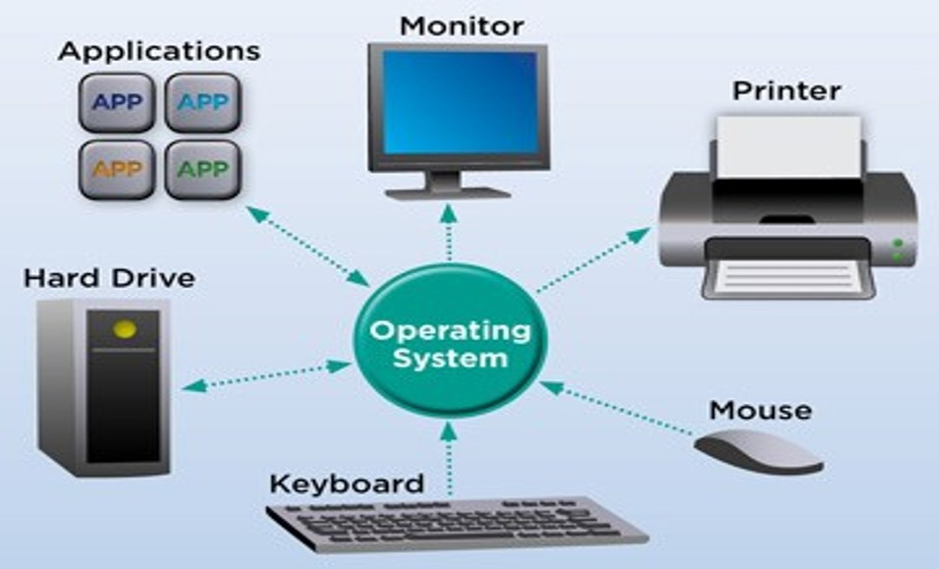
Applications of Virtual Memory
Virtual memory finds extensive applications across a wide range of computing systems and software, enabling seamless operation and efficient resource utilization.
1
Software Development
Virtual memory allows developers to create and run large applications that exceed physical memory limitations.
2
Data Processing
Virtual memory enables efficient handling of massive datasets, essential for applications like data analysis and scientific simulations.
3
Gaming
Virtual memory plays a vital role in modern video games, enabling the loading and rendering of large game worlds and complex graphics.
4
Cloud Computing
Virtual memory is a key technology in cloud computing, enabling the sharing of resources and virtualized environments.

Slide 10
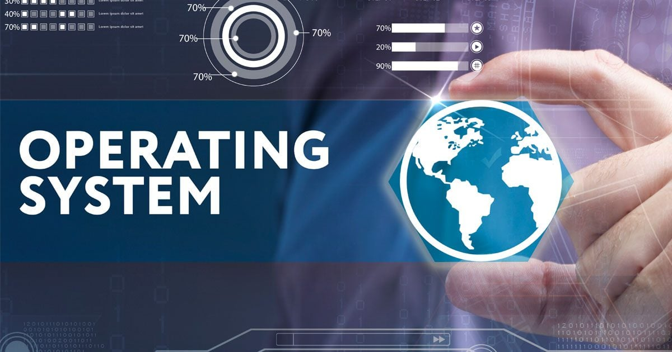

CONCLUSION
Virtual memory is a fundamental concept in modern computing systems, allowing for efficient and flexible memory management. By abstracting physical memory, it enables the execution of large and complex applications that exceed the available physical memory. Techniques such as paging and segmentation facilitate the efficient use of memory resources, while features like memory protection enhance system stability and security. The applications of virtual memory extend to various domains, including operating systems, high-performance computing, and virtualized environments, underscoring its critical role in optimizing memory utilization and improving overall system performance.

